Slide 1
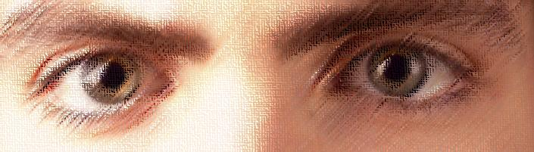

Montana Teen Driver Education and Training
Module 3.1
Effective Vision Control

Slide 2
Key Question
How are driver decisions
and 90% related?
Notes:
Key Answer: 90% of driver decision-making is based on visual cues and habits.

Slide 3
Focus on Vision
1. Visual Skills
What is vision?
How do I use my vision when driving?
How can I develop habits and attitudes to use my visual skills more effectively?
2. Vehicle Control
What habits and attitudes will help me control my car smoothly, efficiently, and safely?
3. Risk Management
  How can I manage the risk associated with driving?
  What habits and attitudes will help me manage risk?
  How can I develop those habits that keep me safe?
Notes:
Focus

Slide 4
Vision Activities
Short Presentations
Short Readings
Problem-solving Activities
Student-centered Activities
Notes:
Vision Activities Overview
Short Presentations
Short Readings
Problem-solving Activities
Student-centered Activities (PEPs)

Slide 5
How Do I See?
The Visual System has four steps
  Data Collection - the Eyes
  Data Transmission - the Optic Nerve
  Data Processing - the Visual Cortex
  4. Perception - the Frontal Cortex
Notes:
You may want to ask the following questions.
1. What are the parts of vision?
2. How do they work with each other to see?
3. What is the role of the eyes?
4. What kind of data do the eyes collect?
5. How does what I see get to the brain?
6. What does the brain do with the things I see once it gets there?
7. How do I perceive what I have seen so that I can understand what it means in the context of my world?
Read the Fact Sheet Vision is a Process for this module to gain a fuller understanding of visual processing and perception.

Slide 6
Student Activity 1
Select the first passage of text to read from the Vision Control Fact Sheet.
Have your partner watch your eyes as you read the text.
Observer: describe to your partner what you see.
Now switch and repeat the activity.
Class discussion: what did everyone else see?
Notes:
These are the first and second student activities. Students will have the opportunity to simultaneously read a passage and have an observer watch their eyes in the first activity and in the second they will watch their partner’s eyes as they scan a picture of a winter driving scene and a vehicle dashboard.
The directions are pretty clear in the presentation so there is no need to repeat the directions.

Slide 7
Student Activity 2
Working in pairs, have one person close his or her eyes.
The teacher will present a slide on the screen while your eyes are closed.
While your partner is watching your eyes, open them and look at the scene.
Observer: describe what you see to your partner.
  Repeat the activity
Notes:
Questions to ask.
1. Why do you think their eyes are doing that?
2. Do you think your eyes do that when you are driving?
3. Why do you think that is?

Slide 8
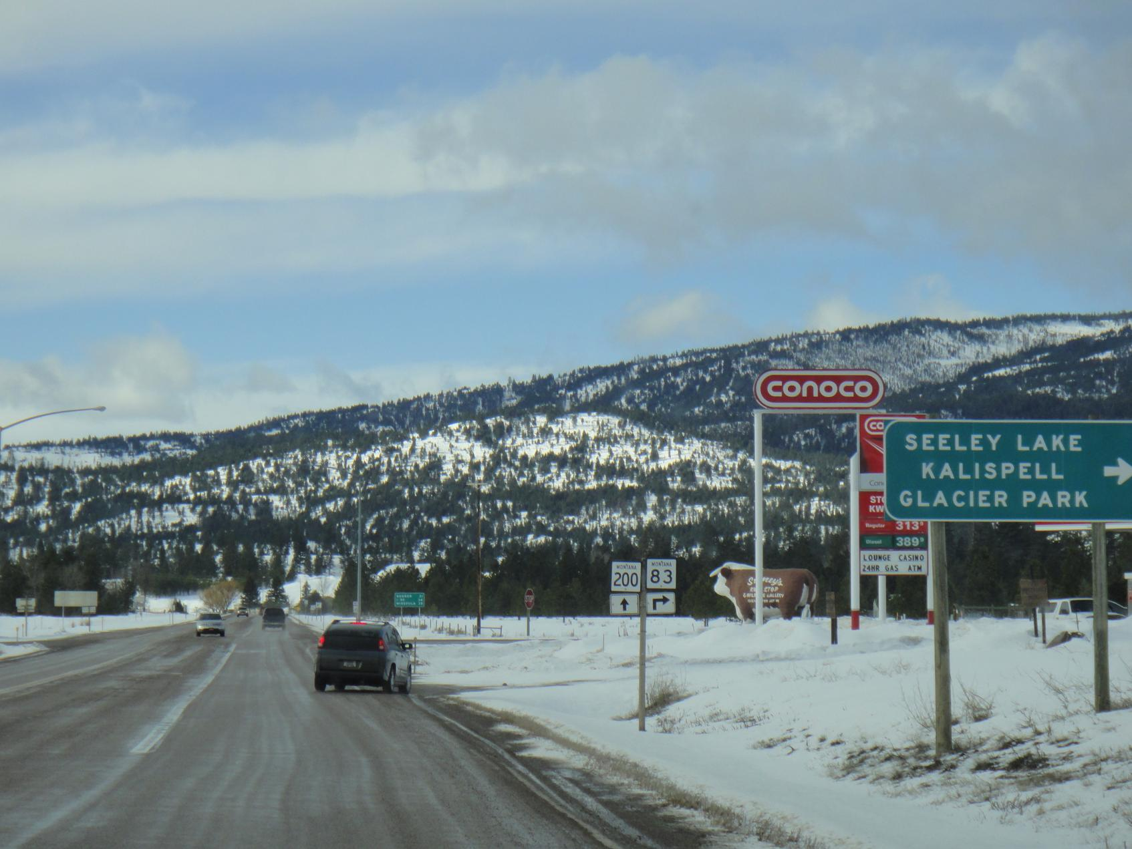
Montana Driver Education and Training 2012
Notes:
Student Activity 2a
Students will have the opportunity to simultaneously read a passage and have an observer watch their eyes in the first activity and in the second they will watch their partner’s eyes as they scan a picture of a winter driving scene and a vehicle dashboard.

Slide 9
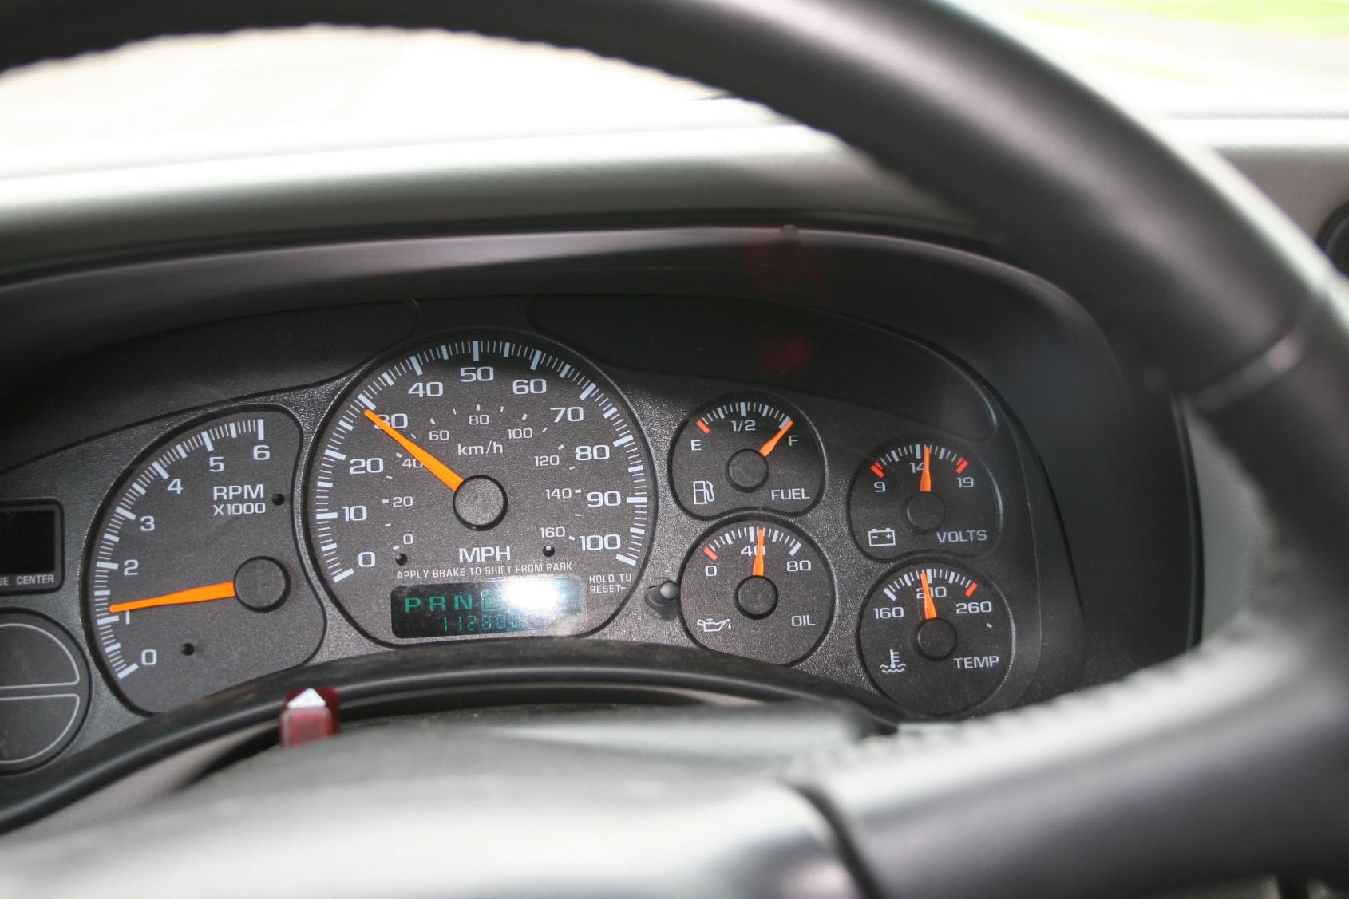
Montana Driver Education and Training 2012
Notes:
Student Activity 2b
Students will have the opportunity to simultaneously read a passage and have an observer watch their eyes in the first activity and in the second they will watch their partner’s eyes as they scan a picture of a winter driving scene and a vehicle dashboard.

Slide 10

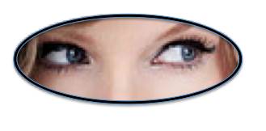
Vision is a process
Notes:
Reading Activity: Paragraphs 2 and 3 of the Vision Control Fact Sheet.
Introduction to vision as a process. The Vision Control Fact Sheet describes how vision works and how each part works together to help us see our world.
Emphasis: Vision is a process that takes time because we have to mentally process the data our eyes deliver to the brain. At a minimum, it takes 3/10 of a second to actually see and perceive an object.

Slide 11
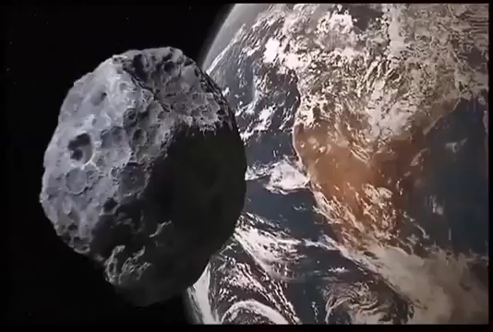
PERCEPTION
PLAY SHORT VIDEO
I will believe it when I see it
Notes:
Perception takes time because it must be processed in the brain. Optical illusions work because the picture presents data that the brain interprets as something that does not exist.

Slide 12
Perception Occurs in the Brain
Perception happens only after the
brain processes what we see.
But We Can Fool our Brain
Our brain tells us what we see even though it might not really exist!
Notes:
Perception

Slide 13
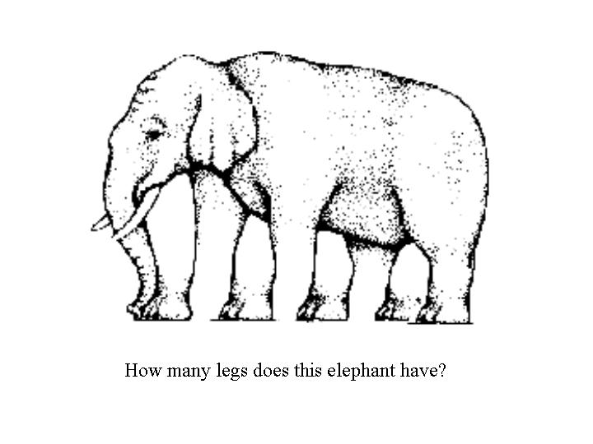

Slide 14

How objects and colors appear is highly dependent on their context. The structural and spatial variables of a scene can influence appearance and perception. The following optical illusion demonstrates how we are sometimes fooled by our eyes.
Instructions: The diagram below features two circles with different surroundings. Would you believe that the two circles are identical?

Slide 15
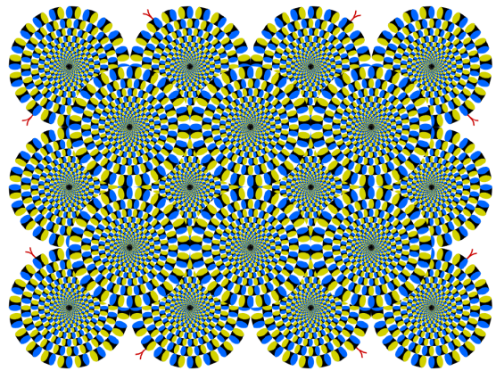
Find Bonus Optical Illusions in the 3.1 Strategies for Visual Control folder.
Notes:
Optical Illusions

Slide 16
Using Your Eyes Effectively
Three Parts of Vision —
each with different roles
    Central Vision
    Fringe Vision
    Peripheral Vision
Notes:
Three Parts of Vision with different roles
In order to see effectively we need to understand how to use our eyes to their fullest to gather information.
Vision is divided into 3 parts.
The central vision is the area of the eye that sees about 3-5 degrees of vision. A part of the retina called the fovea has the highest concentration of cones (color sensing nerves) and provides the best clarity and color vision. When we really want to see something clearly we look directly at it with our central vision.
The fringe vision is the area that surrounds the central vision and is about 30-40 degrees of our visual field. We see less detail but we can gather a tremendous amount of information about our world.
The peripheral vision is the area that is at the edges of what we can see. It is about 170 degrees of our visual field. We see the least amount of detail with this visual area but it gives us information at the edges of our vision. We use our peripheral vision to detect motion and to see changes in shapes and contrast.

Slide 17

The Three Parts of Vision
Central Vision
  Central Vision
  Visual Lead, Targeting, Signs, Signals
Fringe Vision
Peripheral Vision
Fringe Vision
Referencing, Precision Vehicle Placement
Path of Travel
Peripheral Vision
Motion and Changes in Contrast
Notes:
In order to see effectively we need to understand how to use our eyes to their fullest to gather information.
Vision is divided into 3 parts.
The central vision is the area of the eye that sees about 3-5 degrees of vision. A part of the retina called the fovea has the highest concentration of cones (color sensing nerves) and provides the best clarity and color vision. When we really want to see something clearly we look directly at it with our central vision.
The fringe vision is the area that surrounds the central vision and is about 30-40 degrees of our visual field. We see less detail but we can gather a tremendous amount of information about our world.
The peripheral vision is the area that is at the edges of what we can see. It is about 170 degrees of our visual field. We see the least amount of detail with this visual area but it gives us information at the edges of our vision. We use our peripheral vision to detect motion and to see changes in shapes and contrast.

Slide 18
Student Activity 3
View Finder or Thumb Wrinkles Activity for Central and Fringe Vision
Notes:
Student Activity 3

Slide 19
Thumb Wrinkle Activity
Notes:
Student Activity 3
Thumb Wrinkle Activity
Hold your hands out at arm’s length with your thumbs pointing up like you see in the slide.
Look at your thumb wrinkles with your central vision and see the detail of your thumb wrinkles.
Slowly separate your hands while still looking straight ahead. Stop moving your hands when the detail of your thumb wrinkles disappears but you can still see your thumbs. That is the edge of your Fringe Vision.

Slide 20
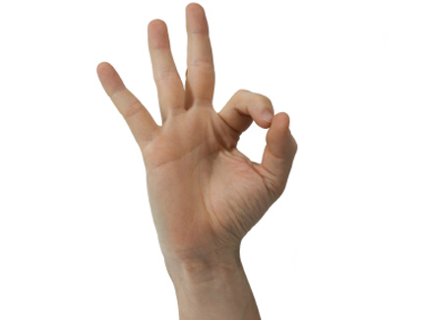
Okee-Dokee Activity
Notes:
Student Activity Okee-Dokee, part two.
1. Make the OK sign with your index finger and thumb.
2. Hold that out at arm’s length and look at a target (door knob, mark on the dry erase board or something similar)
3. That symbolizes your central vision.
4. Pull your hand back and place the OK sign on your face like one side of a pair of glasses and continue to look at your target. What you see is your fringe visual field.

Slide 21
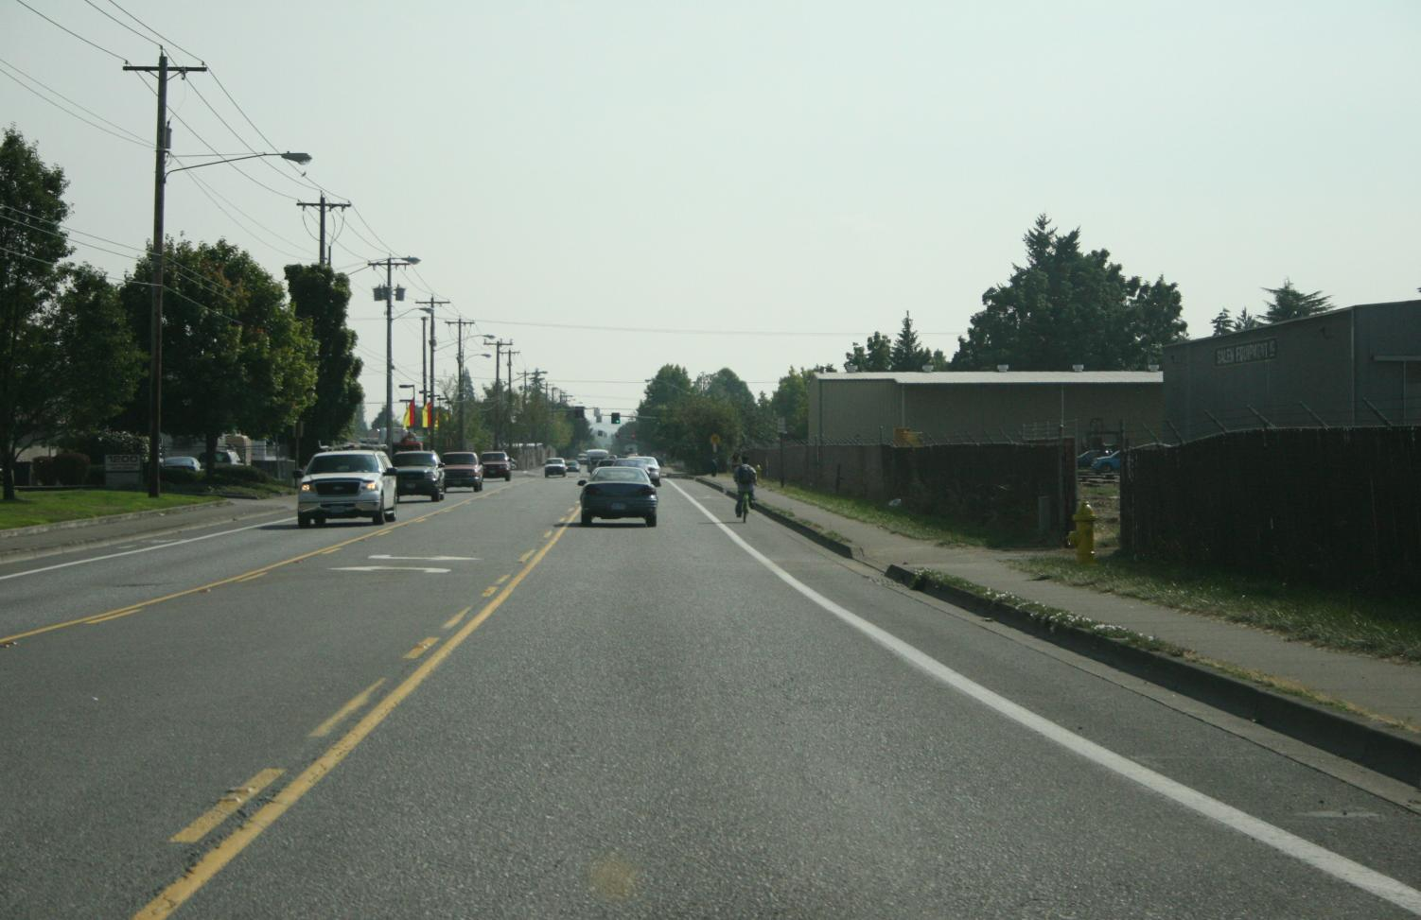
See the target with your central vision
See this area with your fringe vision
Notes:
The yellow circle represents seeing the target with your central vision. The tan represents what you see with your fringe vision. Look at your target and see how much you can see with your fringe vision.
1. Can you see the roadway?
2. Can you see the white and yellow lines?
3. Can you see the oncoming cars?
4. Can you see the bicyclist?

Slide 22
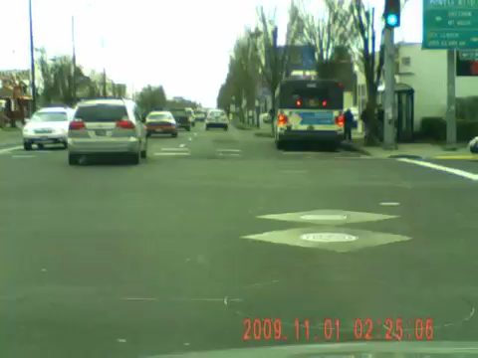
Where did you look and what did you see?
Notes:
Watch the video with your eyes fixed on the target and see how much information you can gather by watching the video.

Slide 23
Student Activity 4
Pick one student to stand in the front of the class.
Using a flashlight, stand to the side of the student and turn it on and off.
Determine the angle where the person can and cannot see the flashlight.
Notes:
This activity is intended to help the student see just how wide their peripheral vision is.

Slide 24
THE VEHICLE CONTROL SEQUENCE
Notes:
Ninety per cent (90%) of the decisions I make while driving are because of what I see. The vehicle control sequence of Vision, Motion and Steering Control happens because I first:
Find the LOS or POT blockage.
Solve the blockage by changing my lane position and speed and I communicate my intentions.
Control: I make sure that my solution still works.

Slide 25
Vehicle Control Sequence
Find—Find it, see it, identify it, realize that you have to do something with it.
Solve—Solve it by determining if you need to slow down, speed up, keep the same speed and whether you need to change lane position to create space.
Control—Making sure that what you decided to do to create space still works as you near your LOS or POT blockage.
For more on Find-Solve-Control read the Module 3.1 Effective Vision Control Factsheet.
Notes:
Ninety per cent (90%) of the decisions I make while driving are because of what I see. The vehicle control sequence of Vision, Motion and Steering Control happens because I first:
Find the LOS or POT blockage.
Solve the blockage by changing my lane position and speed and I communicate my intentions.
Control: I make sure that my solution still works.

Slide 26
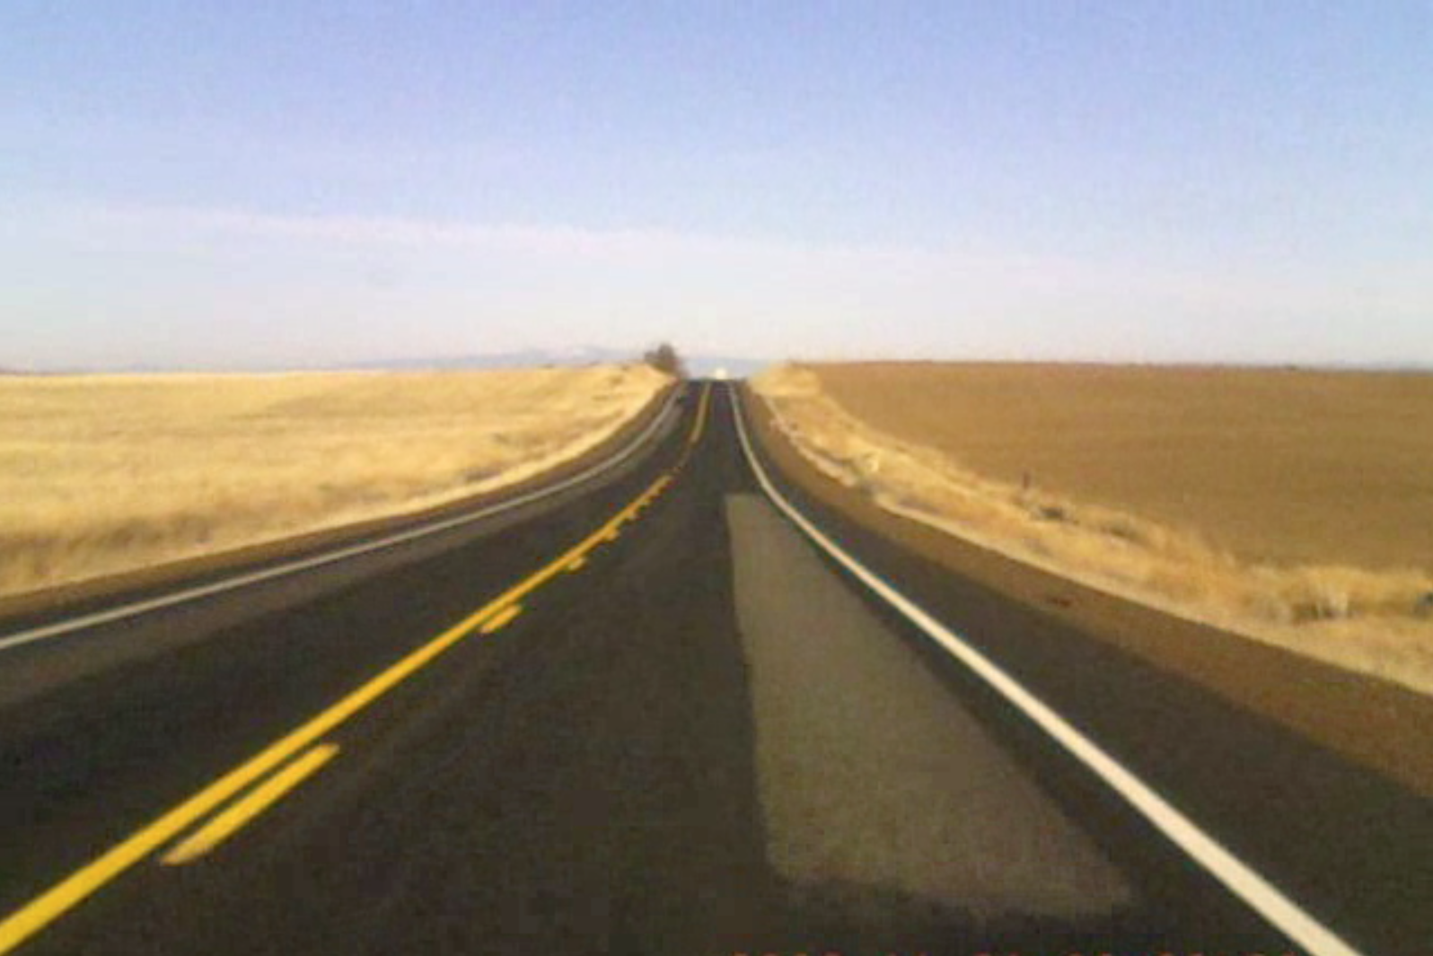
Notes:
These slides show the student the four-step searching process.
Let the slide animate on its own.
Search to the target, the targeting path, left front, and right front. If you back the slide up you can repeat the process and the students can practice it

Slide 27
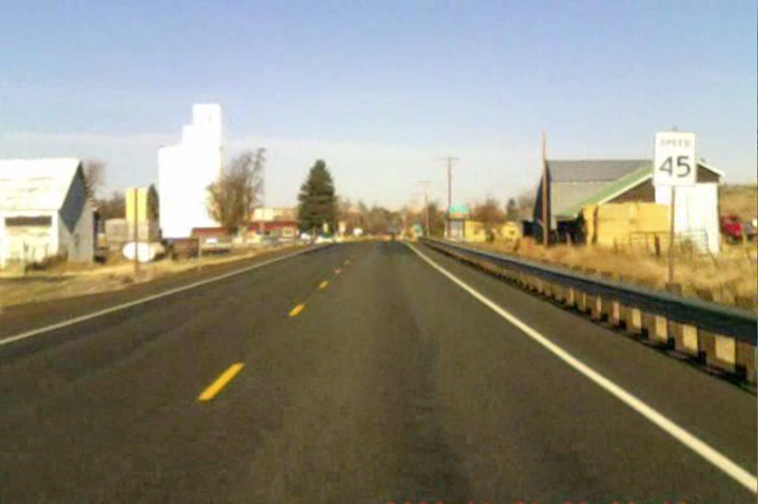
Notes:
These slides show the student the four-step searching process.
Let the slide animate on its own.
Search to the target, the targeting path, left front, and right front. If you back the slide up you can repeat the process and the students can practice it

Slide 28
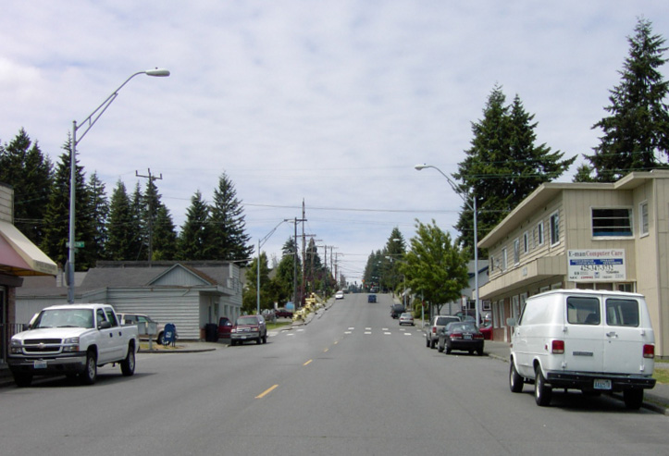
Using the searching strategy you just learned, answer the following questions with your partner.
How is your 1. target area? 2. path of travel? 3. left front zone? 4. right front zone?
1. Hill, signal, and car, 2. Open, but may close as I get closer to the crosswalk, 3. Open, 4. Closed because of the van.
Notes:
Identify the LOS-POT blockages and then decide what you are going to do with them. Each slide has the questions on them with the answers at the bottom. This is a good activity for students to work in groups of two or three.
Find • Solve • Control

Slide 29
Now that you know what LOS and POT issues you will encounter, what will you do in the vehicle control sequence?
Slow down, move to LP 2 and search around the front of the van.
Notes:
Identify the LOS-POT blockages and then decide what you are going to do with them. Each slide has the questions on them with the answers at the bottom. This is a good activity for students to work in groups of two or three.
Find • Solve • Control

Slide 30
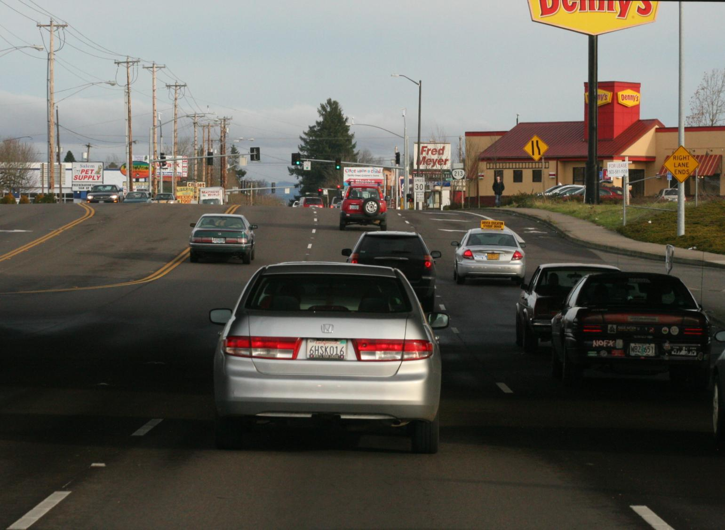
How is your 1. target area? 2. path of travel? 3. left front zone? 4. right front zone?
Closed because of the cars and upcoming signal, 2. Closed because of traffic and about to become more congested, 3. Open, 4. Closed.
What are your choices?
Notes:
Identify the LOS-POT blockages and then decide what you are going to do with them. Each slide has the questions on them with the answers at the bottom. This is a good activity for students to work in groups of two or three.
Find • Solve • Control

Slide 31
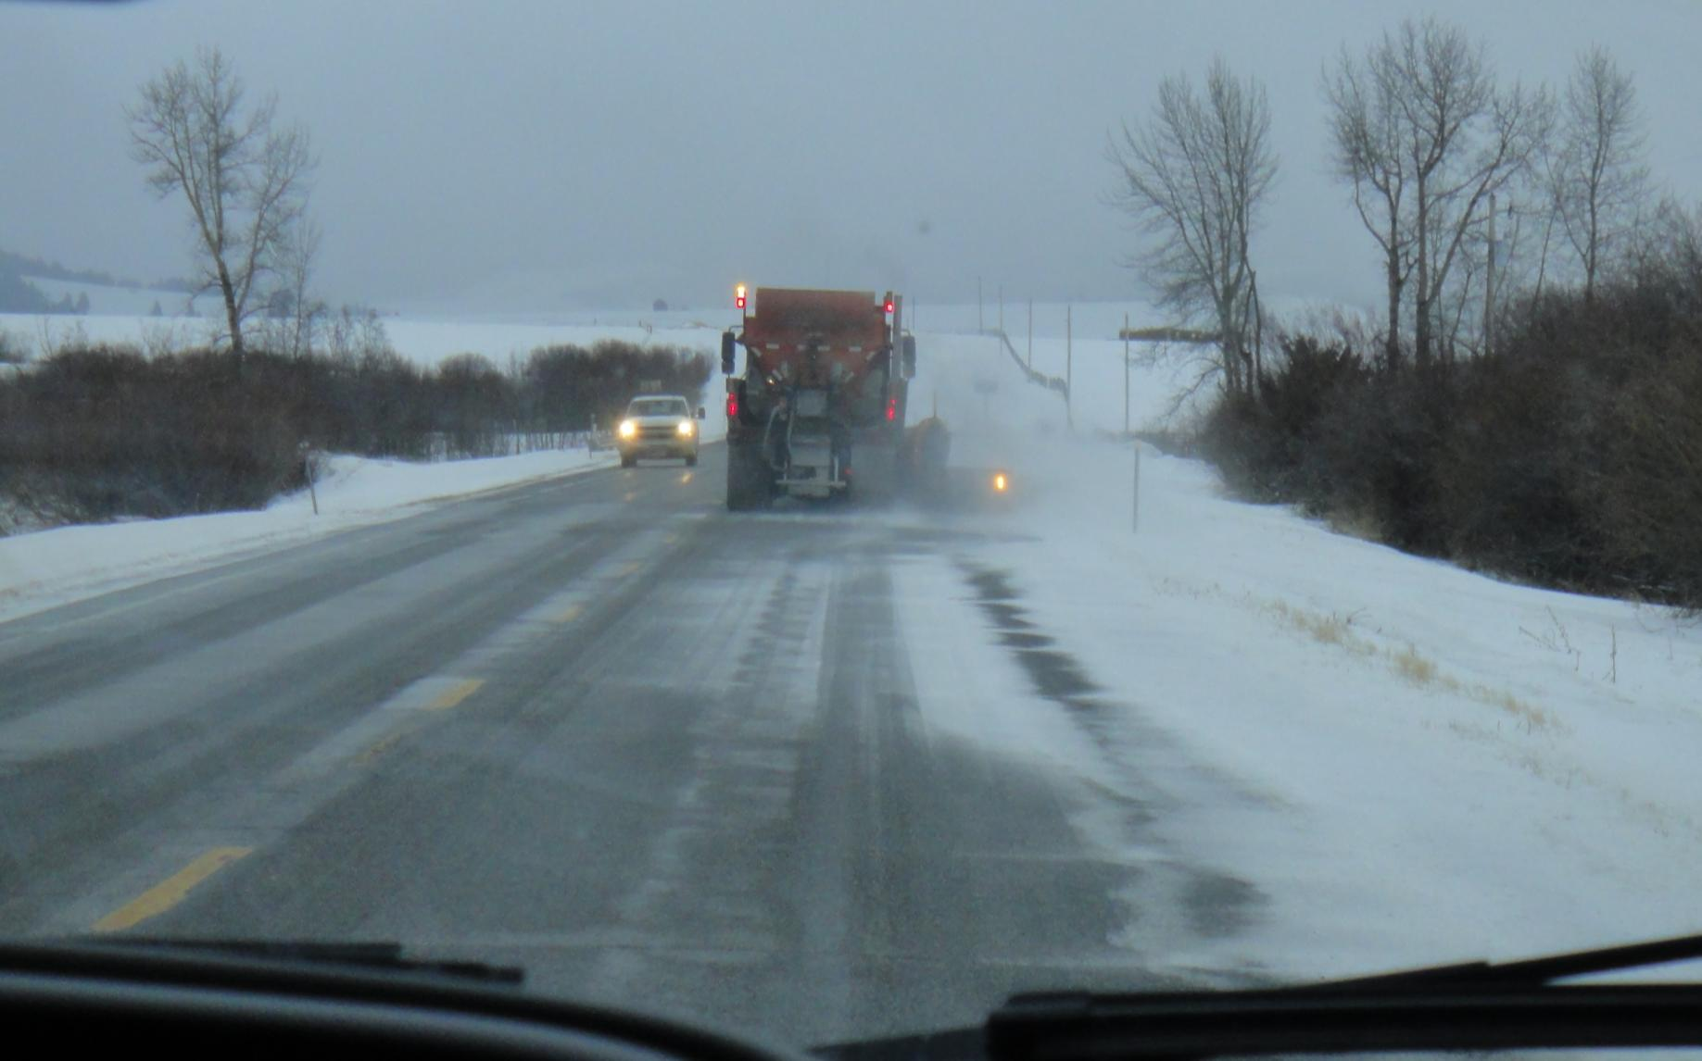
How is your 1. target area? 2. path of travel? 3. left front zone? 4. right front zone?
1. Closed because of the snow plow,
2. Closed by the icy and snowy road,
3. Closed by the oncoming pickup,
4. Closed by the snow bank.
What are your choices?
Notes:
Identify the LOS-POT blockages and then decide what you are going to do with them. Each slide has the questions on them with the answers at the bottom. This is a good activity for students to work in groups of two or three.
Find • Solve • Control

Slide 32
Driving is not a static activity. The vehicle control sequence must be repeated during your entire drive.
Vehicle Control Sequence
Notes:
Driving is not a static process. These videos have the student scan a video of a car driving down a street in a neighborhood. The car stops for some reason and as the car is there a young boy runs across the street in front of the car.
Slide 36 has the discussion question you can ask the students and then repeat the activity by watching the video over again on slide 37.

Slide 33
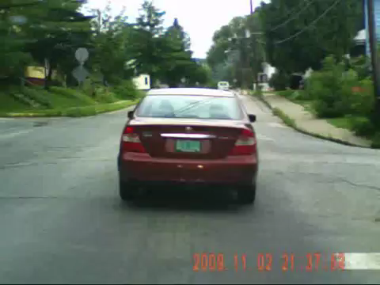
Exercise the Vehicle Control Sequence during the short drive.
Notes:
Driving is not a static process. These videos have the student scan a video of a car driving down a street in a neighborhood. The car stops for some reason and while the car is stopped a young boy runs across the street in front of the car.
Slide 36 has the discussion question you can ask the students and then repeat the activity by watching the video over again on slide 37.

Slide 34
Did You See Him?
Where were you looking?
What were you looking for?
Why did you miss the pedestrian?
What do you need to do to See?

Slide 35
Watch the video again. See if you can FIND the pedestrian.
Notes:
Video

Slide 36
DEALING WITH VISION ISSUES
If 90% of our decisions are based on what we see, it is important that we deal effectively with vision issues.
Notes:
How do I deal with vision issues and how do I solve them? This is a great student-centered activity and lets the students work in groups to:
1. Identify the problem
2. Propose a solution
3. Have a class discussion sharing their outcomes.

Slide 37
Student Activity 5
Work in groups of 2 or 3
Look at the next set of pictures and discuss the following
  What is the vision problem demonstrated here?
  What do I need to do to solve the problem?
  See the Vision Control Factsheet for more information.
Notes:
How do I deal with vision issues and how do I solve them? This is a great student-centered activity and lets the students work in groups to:
1. Identify the problem
2. Propose a solution
3. Have a class discussion sharing their outcomes.

Slide 38
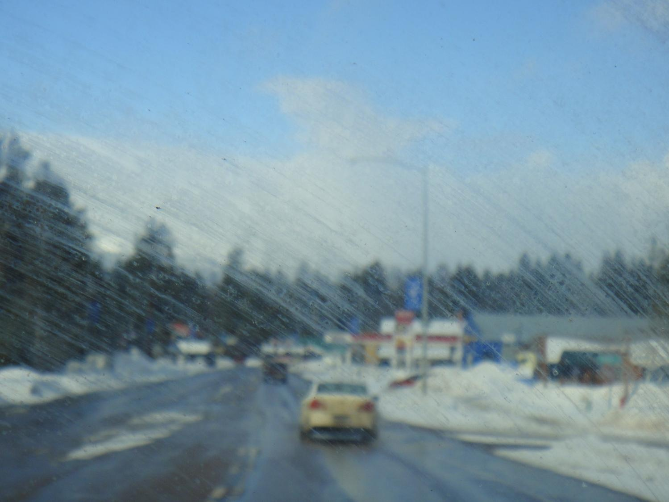
Notes:
Vision Problem
Windshield has streaks of mud and road debris smudged by the wiper blades. Road is wet and will only continue to put water and dirt on my windshield.
Solution
Use windshield washer to clean window. If washer does not clean window. stop and clean it at a service station. Fill the washer reservoir with an antifreeze washer fluid and possibly change the wiper blades.

Slide 39
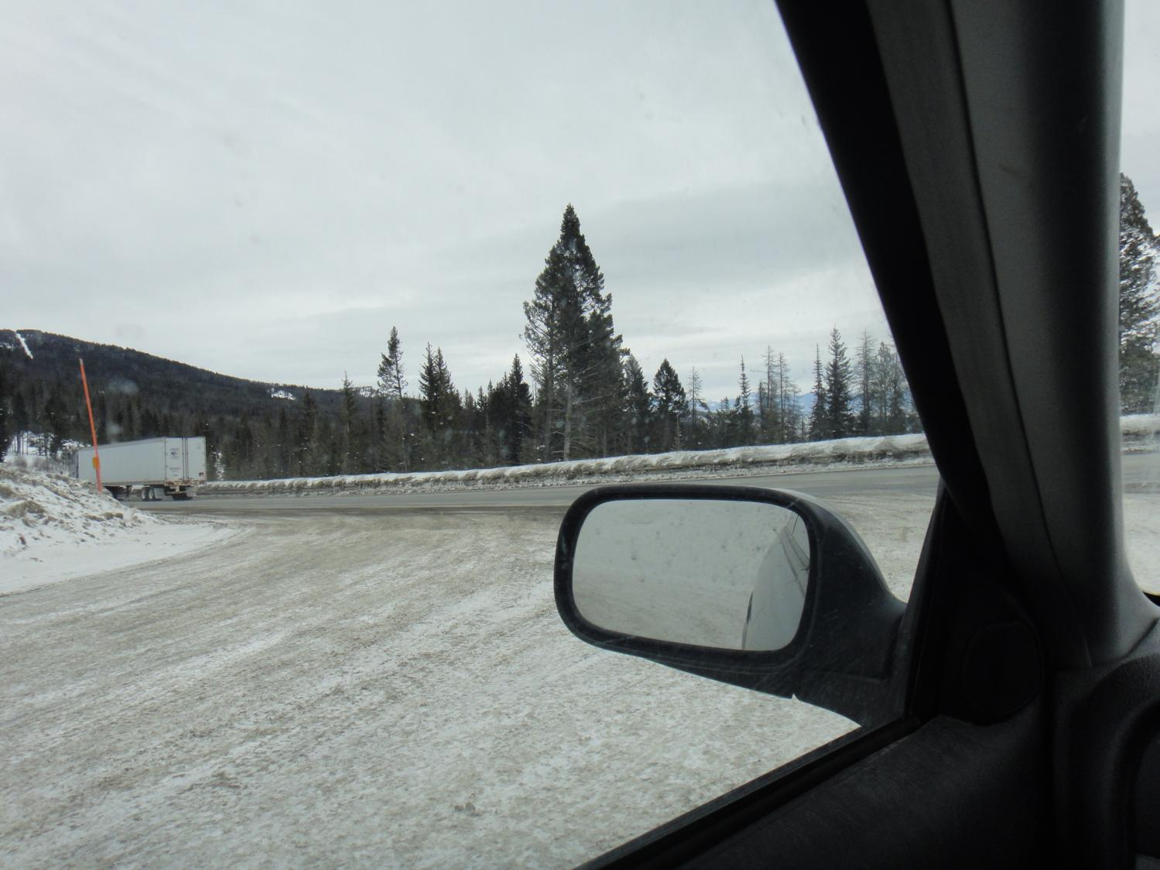
Notes:
Vision Problem
View of the road is blocked by the snow bank and I don’t have a clear view of the road to safely turn onto the highway.
Solution
Check your front zone, use your forward reference point to move to the edge of the road and stop. Scan the road for traffic and go when safe.

Slide 40
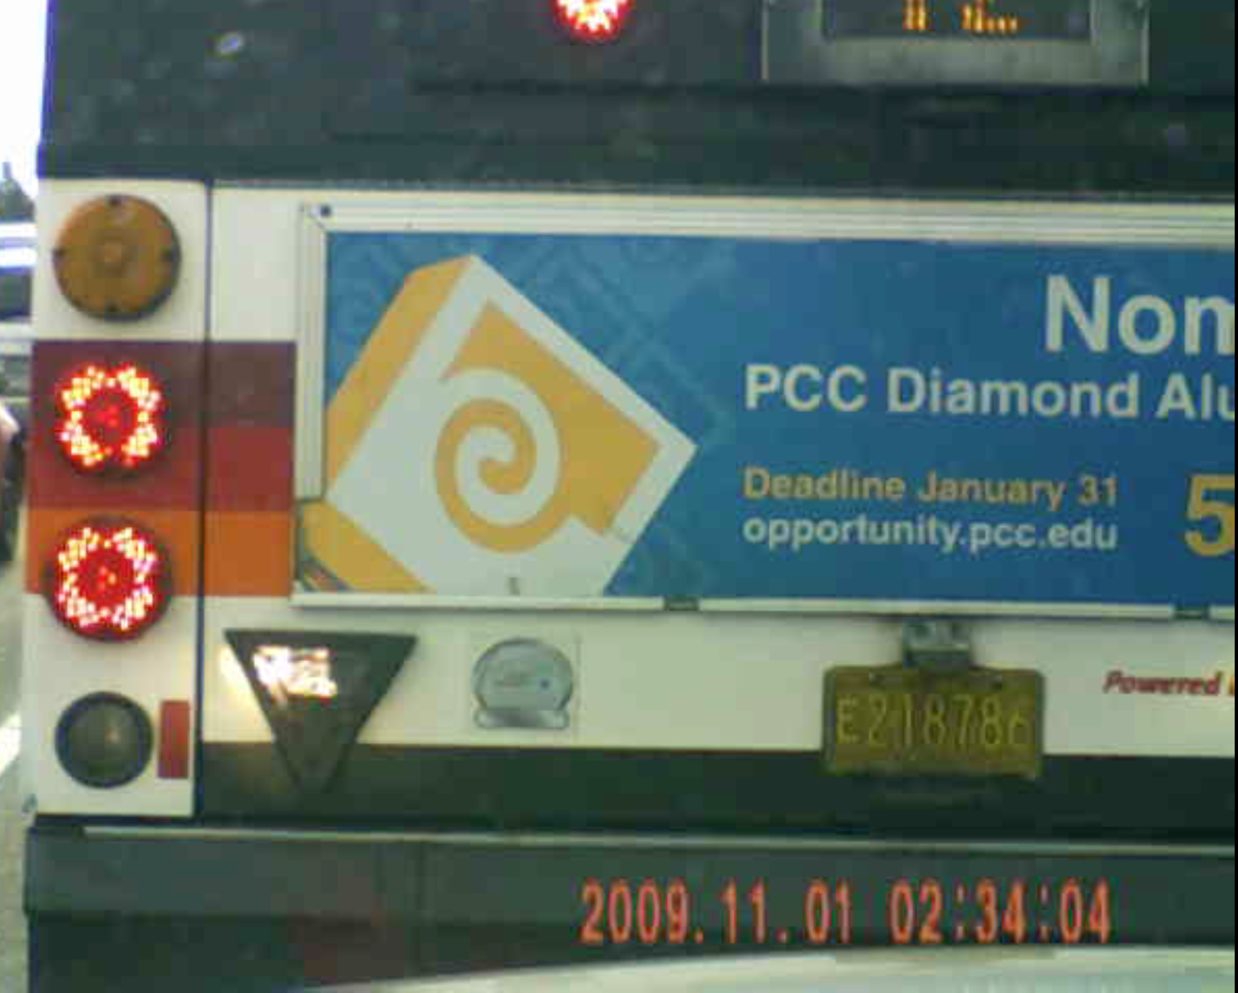
Notes:
Vision Problem
Stopped bus blocks my view of road ahead.
Solution
Anticipate that a bus with brake lights on is going to stop. If you can, change lanes and open up your LOS. If you can’t, make sure to stop far enough behind the bus to see the back tires touching the pavement to open your LOS and to give you room to maneuver around the bus in case the driver is taking a break.

Slide 41
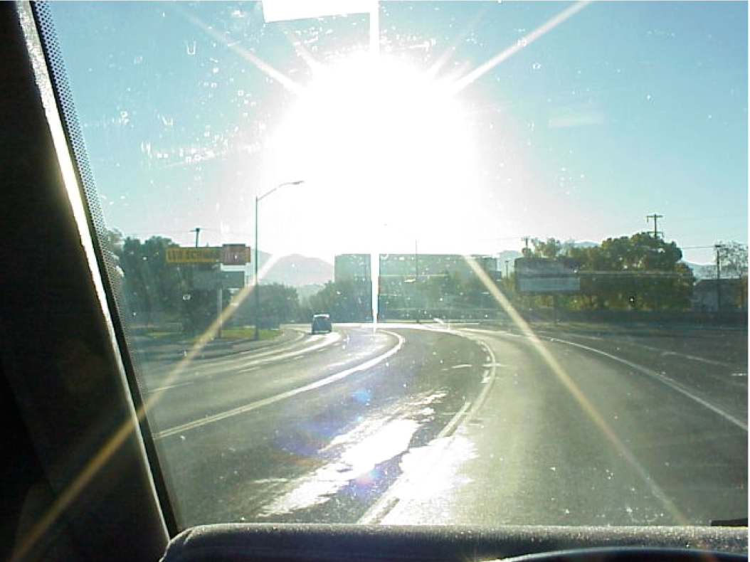
Notes:
Vision Problem
Sun glare makes it difficult to see ahead.
Solution
Anticipate that you will have sunny days in Montana and that you should: clean the windows to reduce glare, have sunglasses handy, use the visor to reduce direct glare and look to the right edge of the roadway to minimize the effect of the glare on your vision.

Slide 42
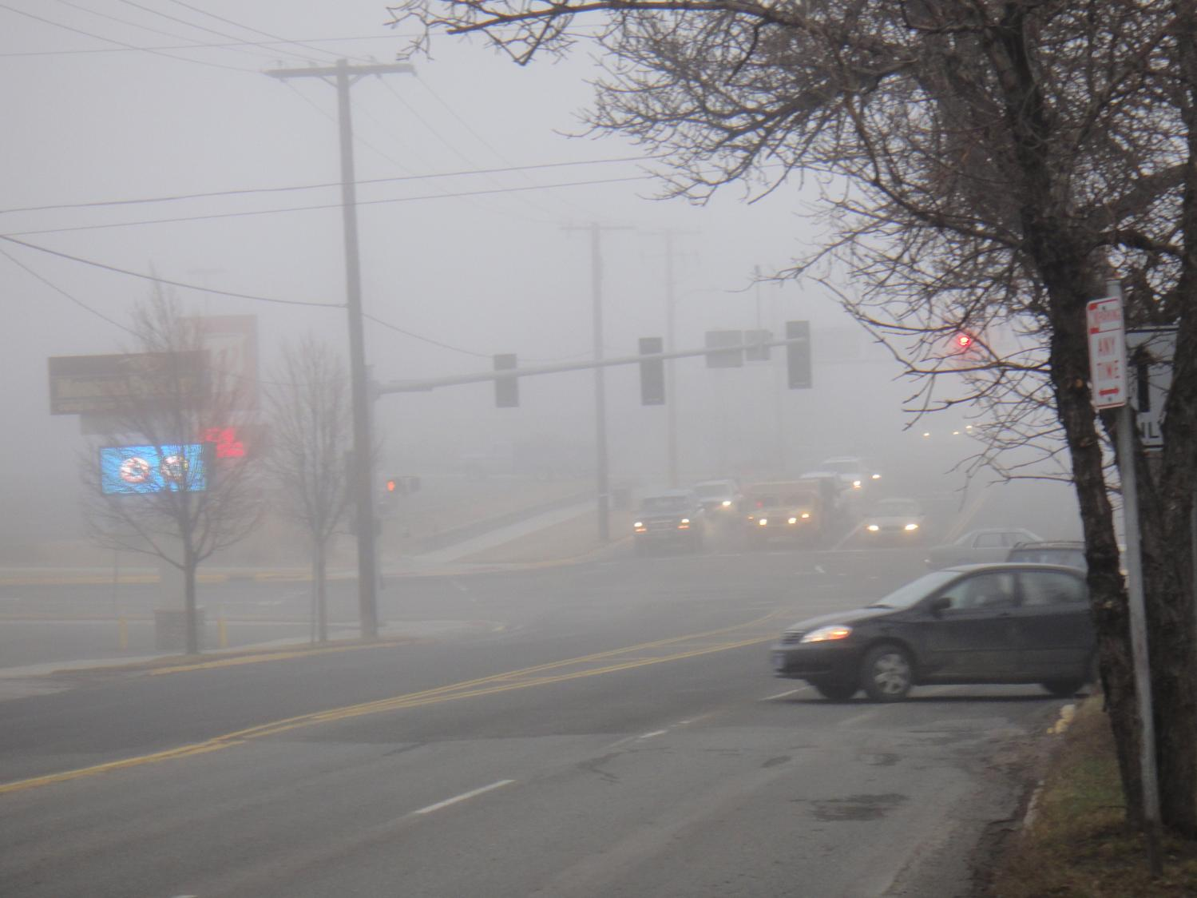
Notes:
Vision Problem
Fog limits my ability to see others and to judge distance effectively. It reduces my color vision and the contrast between the background and the cars and people I am searching for. It also reduces my depth perception and makes things look further away than they really are.
Solution
Clean windows, use your headlights so others will see you, increase following distance, scan more than once when entering traffic and realize that cars may be closer than you think, so allow a little longer space to execute a merge or enter traffic.

Slide 43
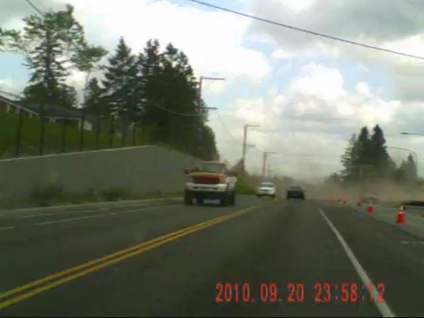
Notes:
VIDEO
Vision Problem
Dust blowing across road is similar to fog. It limits my ability to see very far in the dust storm.
Solution
Clean windows, use your headlights so others will see you, increase your following distance and anticipate that others might stop unexpectedly or turn in front of you.

Slide 44
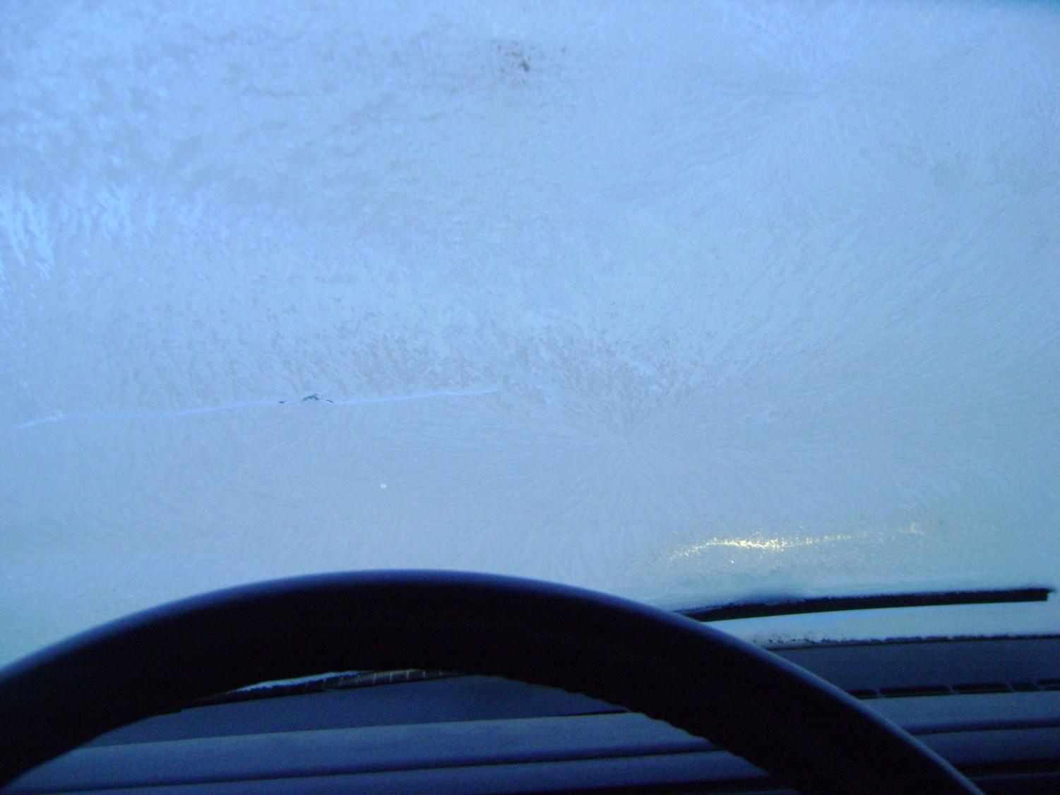
Notes:
Vision Problem
Frost on the windows. Scraping a small port-hole to see out still limits my vision and spraying water on my windows causes them to freeze and block my view.
Solution
Scrape the entire window and run the defroster on high until the window is clear. Remember that you have to have a complete view of the roadway in order to make informed driving decisions and the risk of hitting someone increases drastically with such limited visibility.

Slide 45
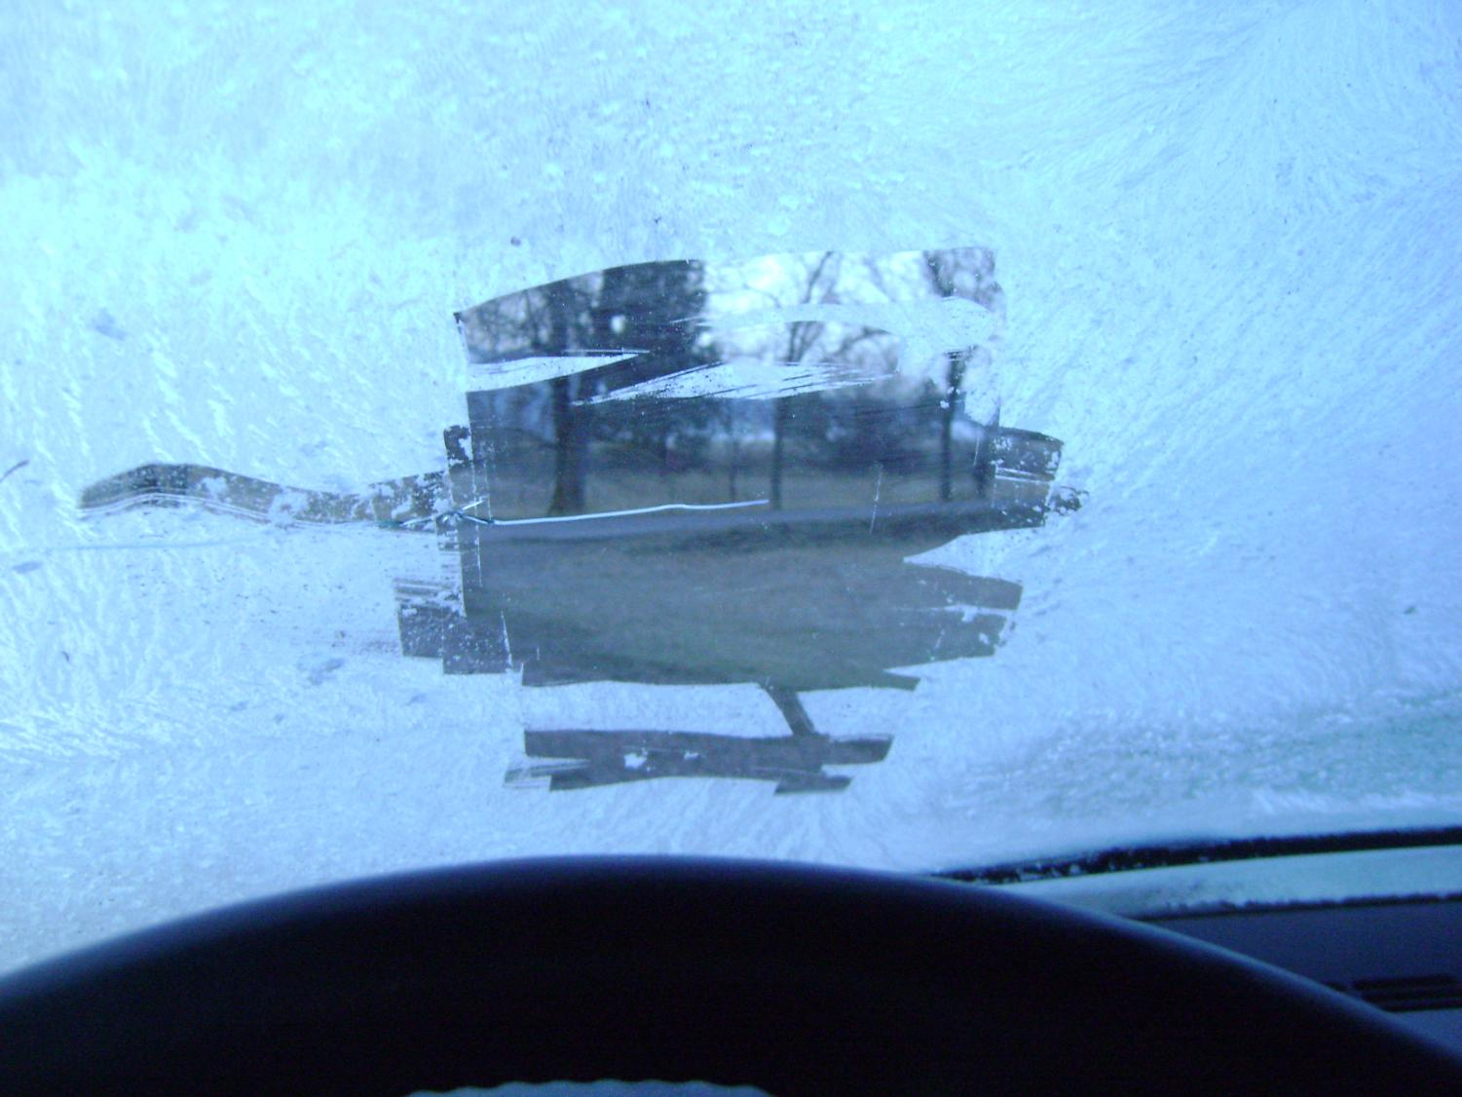
Notes:
Vision Problem
Frost on the windows. Scraping a small port-hole to see out still limits my vision and spraying water on my windows causes them to freeze and block my view.
Solution
Scrape the entire window and run the defroster on high until the window is clear. Remember that you have to have a complete view of the roadway in order to make informed driving decisions and the risk of hitting someone increases drastically with such limited visibility.

Slide 46
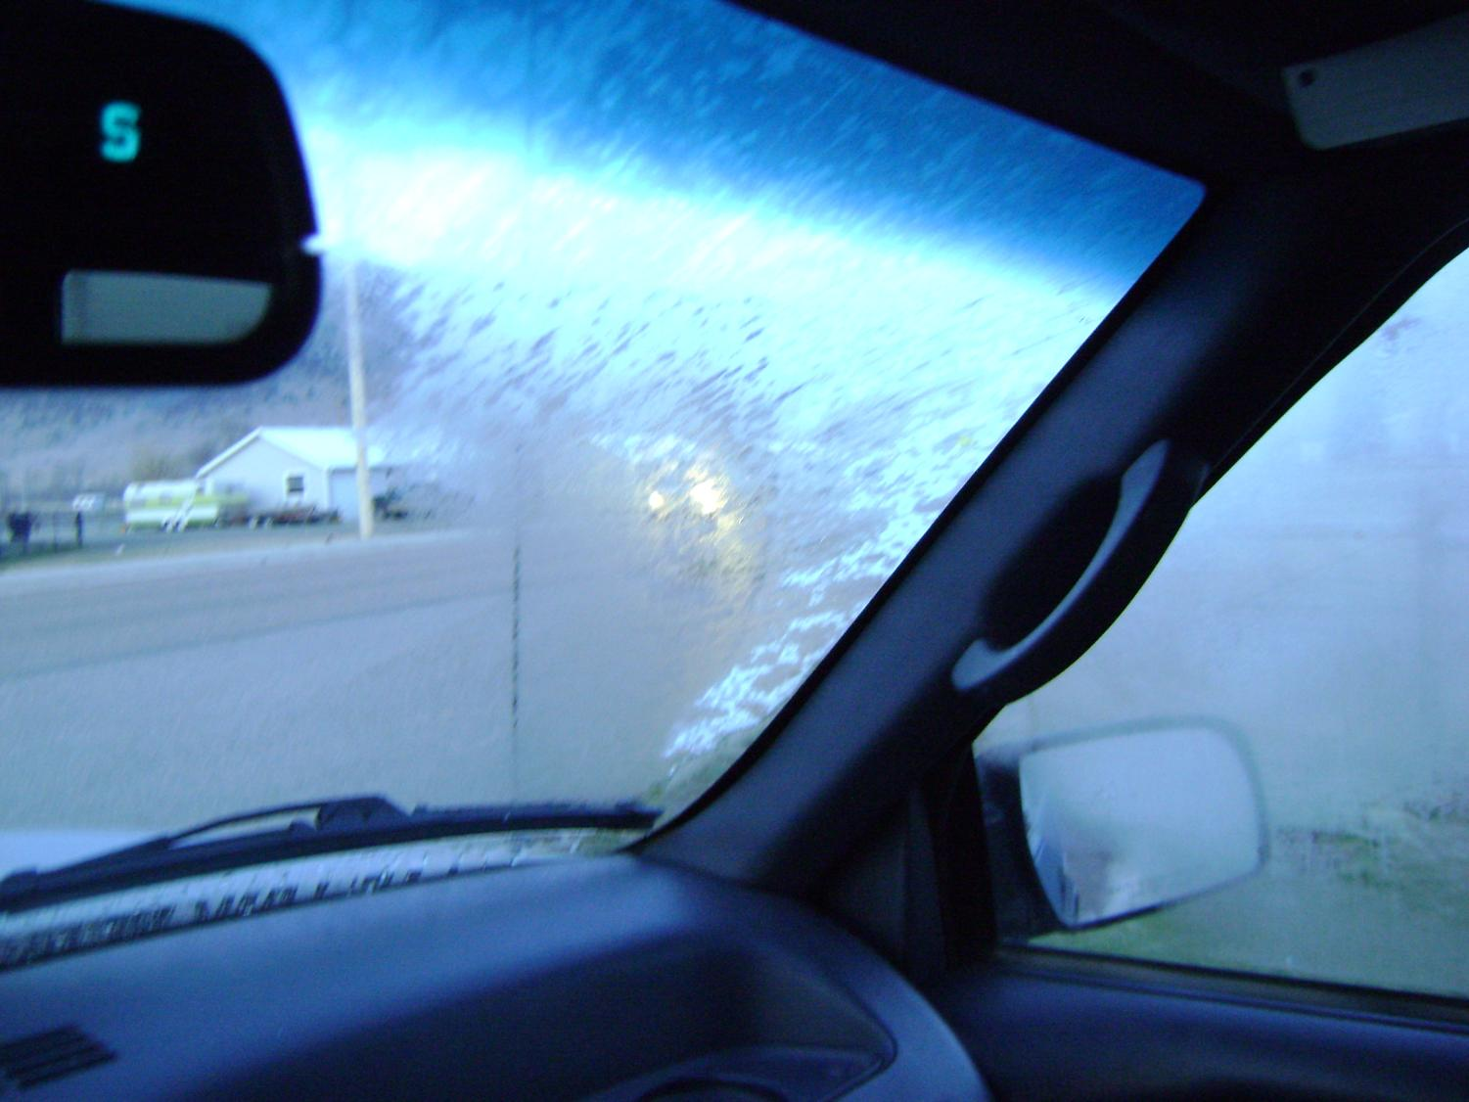
Notes:
Vision Problem
Frost on the windows. Scraping a small port-hole to see out still limits my vision and spraying water on my windows causes them to freeze and block my view.
Solution
Scrape the entire window and run the defroster on high until the window is clear. Remember that you have to have a complete view of the roadway in order to make informed driving decisions and the risk of hitting someone increases drastically with such limited visibility.

Slide 47
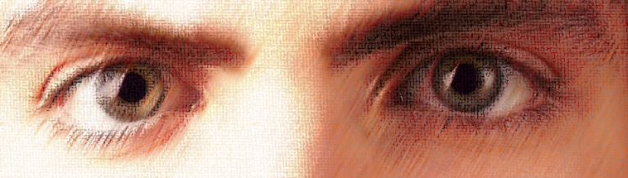
Our Speed Affects Our Ability to See
The faster we go the less information we can see.
Why?
Notes:
As I increase speed I reduce my ability to gather critical information. It takes time to see because our eyes have to stop briefly to allow the information to be gathered and processed.
That’s because I can’t move my eyes fast enough to collect all the data that is passing by. I narrow my visual field to avoid developing eye fatigue.

Slide 48
Our Speed Affects Our Ability to See
Remember the first activity you did? What were your eyes doing as you read the passage or scanned the picture?
Read Module 3.1 Vision Control Factsheet section on Speed and Vision
Notes:
I go 37 feet per second if I travel at 25 MPH.
If it takes 3/10 of a second to “see” something then I will travel 11 feet each time my eyes pause to gather information.
I go 105 feet per second if I travel 70 miles per hour. I go 35 feet every time my eyes pause to gather information.

Slide 49
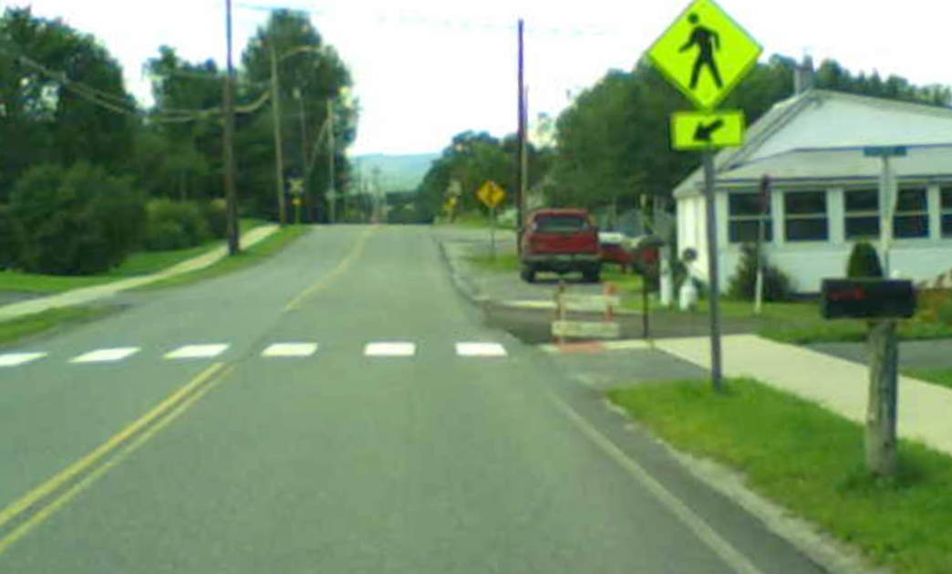
Visual Field at 25 MPH
Notes:
Question: What do you see when you scan this photo which simulates going at a speed of 25 mph?

Slide 50
Visual Field at 60 MPH
Your Visual Field Shrinks to the Size of the Clear Area
Information about other users and LP is less
Ability to detect hazards is reduced
LOOK AT HOW MUCH YOU MISS!!!
Notes:
Answer:
• Visual Field Shrinks to the size of the clear area
• Information about other users and LP is less
• Ability to detect LOS and POTs is reduced
• NOTICE HOW MUCH YOU MISS!!!

Slide 51
Vision is a process that gets better with practice and by developing good habits.
Notes:
Summary slide that introduces the idea that good vision control is a result of developing good habits.

Slide 52
Strategies for
DEVELOPING GOOD DRIVING HABITS
and
EFFECTIVE VEHICLE CONTROL
Notes:
Strategies for Developing Good Driving Habits and Effective Vehicle Control

Slide 53
Six Steps to Positive Habit Development
Identify the behavior and desire to do it
Demonstrate ability to perform the behavior.
Overcome resistance of “this is the way I do it.”
Understand and identify when the behavior is performed correctly or incorrectly.
Practice the behavior correctly at least 28 times.
Perform the behavior correctly without thought.
Notes:
Describes the process of habit development. The Habits Fact Sheet covers these principles in detail and would be good homework for students to look over and come to class prepared for a discussion the next day.

Slide 54

Driver Judgment
Like athletes and musicians, drivers can learn what to do without hesitation with a good judgment level of awareness
It takes a desire to be a good driver
Precision driving does not rely on luck, fate, or maneuvering skills, it relies on …
Notes:
Describes the process of habit development. The Mod Five Habits Fact Sheet covers these principles in detail and would be good homework for students to look over and come to class prepared for a discussion the next day.

Slide 55
Four Levels of Performance
            Level 1 — Unconsciously Competent:
            I don’t have to think about what I know and what I can do, but I do it well
        Level 2 — Consciously Competent:
        I am aware of what I know and what I can do and what I need to do to continue to improve
    Level 3 — Consciously Incompetent:
    I am aware of what I don’t know and what I can’t do and I am willing to work on getting better!
Level 4 — Unconsciously Incompetent:
I am unaware of what I don’t know and what I can’t do
Notes:
All of us drive at some level of performance. Each level is described and questions you may want to ask are:
What level do you think you drive at?
Where do you think your parents drive at?
What levels do you think you are able to learn new ideas, attitudes, and skills? Why do you think that is?
What do you want to do with what you have learned today? Do you think you can change your driving even if you have been driving for a long time?
If you want to be a good driver, what do you have to do?

Slide 56
Learning and changing behavior can only happen in Levels 2 and 3!
Are you more aware of the need to develop good habits and are willing to improve your visual searching skills behind the wheel?
Write about what you need to know and practice to be a safe and skilled driver.
Journal Writing Prompt

Slide 57
Montana Driver Education and Training
Standards and Benchmarks
1. Laws and Highway System
  1.1. know the laws outlined in the Montana Driver's manual;
  1.2. understand the laws outlined in the Montana Driver's Manual; and
  1.3. consistently demonstrate knowledge and understanding by responsible adherence to highway transportation system traffic laws and control devices.
2. Responsibility
  2.1. recognize the importance of making safe and responsible decisions for owning and operating a motor vehicle;
  2.2 demonstrate the ability to make appropriate decisions while operating a motor vehicle;
  2.3. consistently display respect for other users of the highway transportation system; and
  2.4. develop positive habits and attitudes for responsible driving.
3. Visual Skills
  3.1. know proper visual skills for operating a motor vehicle;
  3.2. communicate and explain proper visual skills for operating a motor vehicle;
  3.3. demonstrate the use of proper visual skills for operating a motor vehicle; and
  3.4. develop habits and attitudes with regard to proper visual skills.
4. Vehicle Control
  4.1. demonstrate smooth, safe and efficient operation of a motor vehicle; and
  4.2. develop positive habits and attitudes relative to safe, efficient and smooth vehicle operation.
5. Communication
  5.1. consistently communicate driving intentions (i.e., use of lights, vehicle position, and personal signals);
  5.2. adjust driver behavior based on observation of the highway transportation system and other roadway users;
  5.3. adjust communication (i.e., use of lights, vehicle position, and personal signals) based on observation of the highway transportation system and other users; and
  5.4. develop positive habits and attitudes for effective communication.
6. Risk Management
  6.1. understand driver risk-management principles;
  6.2. demonstrate driver risk-management strategies; and
  6.3. develop positive habits and attitudes for effective driver risk-management.
7. Lifelong Learning
  7.1. identify and use a range of learning strategies required to acquire or retain knowledge, positive driving habits, and driving skills for lifelong learning;
  7.2. establish learning goals that are based on an understanding of one’s own current and future learning needs; and
  7.3. demonstrate knowledge and ability to make informed decisions required for positive driving habits, effective performance, and adaptation to change.
8. Driving Experience
  8.1. acquire at least the minimum number of BTW hours over at least the minimum number of days, as required by law, with a Montana-approved driver education teacher; and
  8.2. acquire additional behind-the-wheel driving experience with a parent or guardian’s assistance in a variety of driving situations (i.e., night, adverse weather, gravel road, etc.).
Notes:
Standards and Benchmarks: This is for your reference and not to be read to the class verbatim. Please review prior to the lesson so you are aware of what the student will be required to know at the end of the module.

